Slide 1
Structures in C
Prepared by:
Dhrumil Mehta
Shrey Goel
Himanshu Rajput
Rahul Bakawat
Dharmraj Chauhan
Divyrajsinh Rana

Slide 2
Contents
Creating a structure
Array of structures
Nesting structures
Pointers
Array with pointers
Pointers in structures
Structure pass as function
Structure padding and packing
Using bit fields
Reading & Writing of raw data

Slide 3
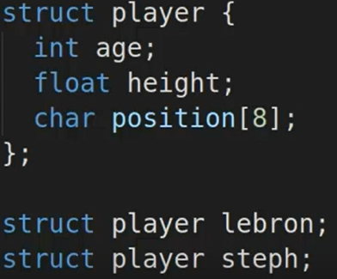
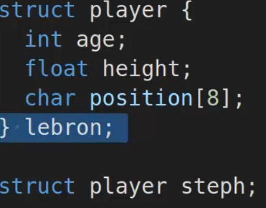
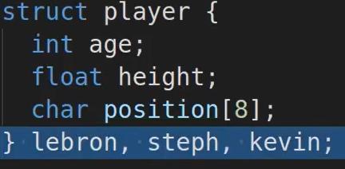
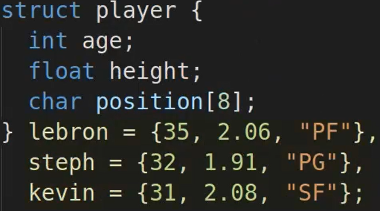
Creating a structure

Slide 4
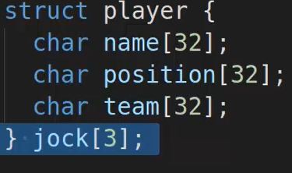
Array of structures

Slide 5
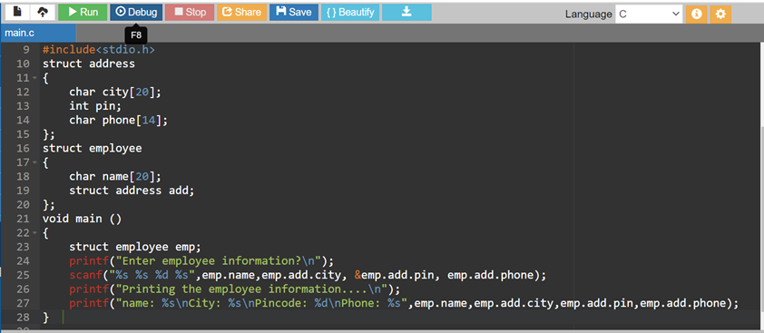
Nested Structures
C provides us the feature of nesting one structure within another structure by using which, complex data types are created.

Slide 6
Array with pointers
Pointers are variables which stores the address of another variable. When we allocate memory to a variable, pointer points to the address of the variable.
Unary operator(*) is used to declare a variable and it returns the address if the allocated memory.
Pointers to an array points the address of memory block of and array variable.
Syntax : datatype *variable_name[size];
Eg : int *arr[3];

Slide 7
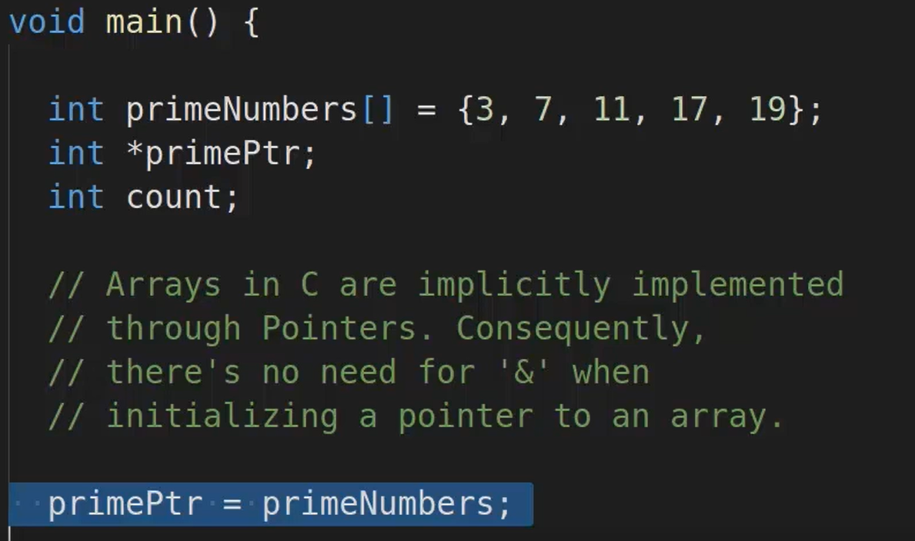
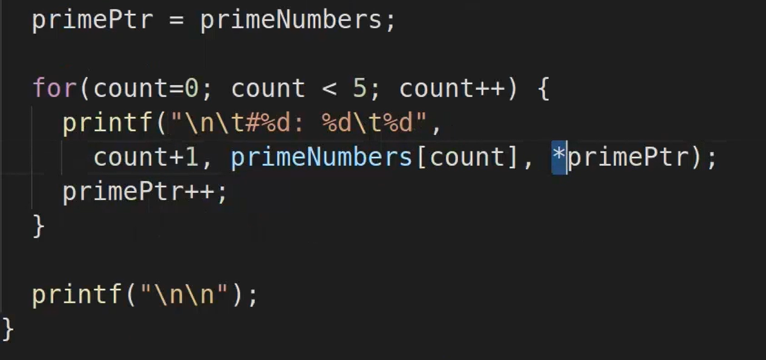
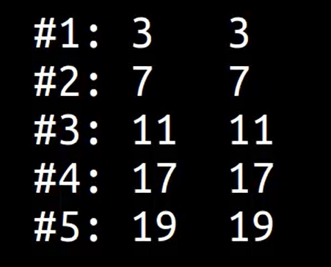
Array with pointers

Slide 8
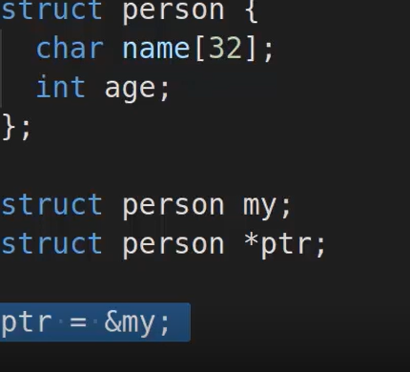
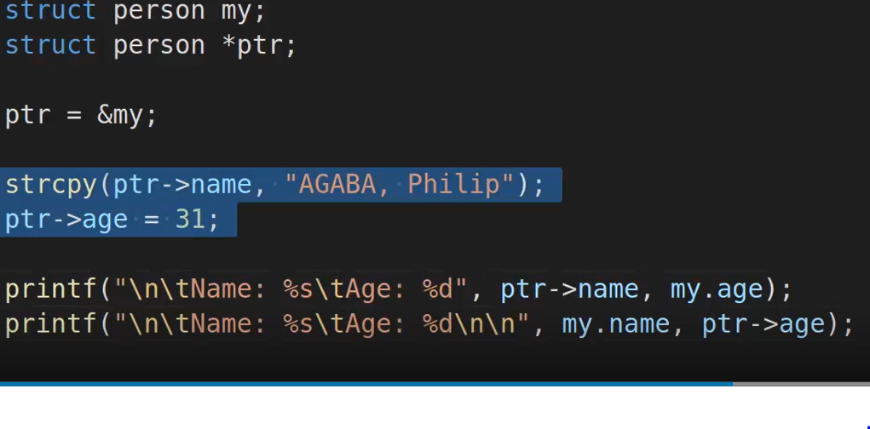
Pointers in structures

Slide 9
Pass a Structure to Function
Structures and Functions in C :
The C Programming allows us to pass the structures as the function parameters. We can pass the C structures to functions in 3 ways:
Passing each item of the structure as a function argument.
Pass the whole structure as a value.
We can also Pass the address of the structure (pass by reference).

Slide 10
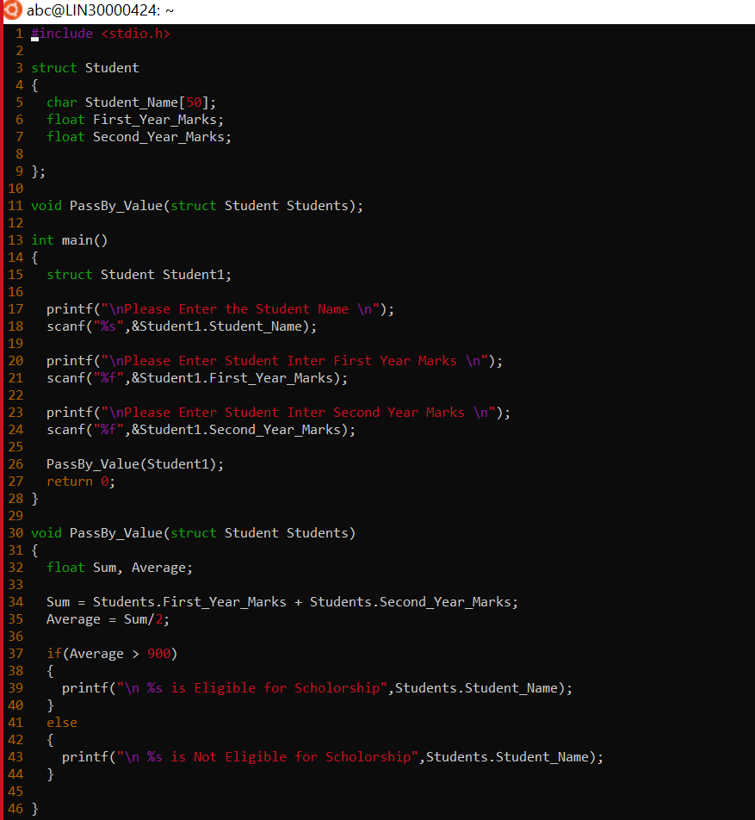
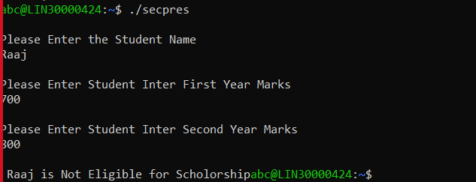
Call by Value

Slide 11
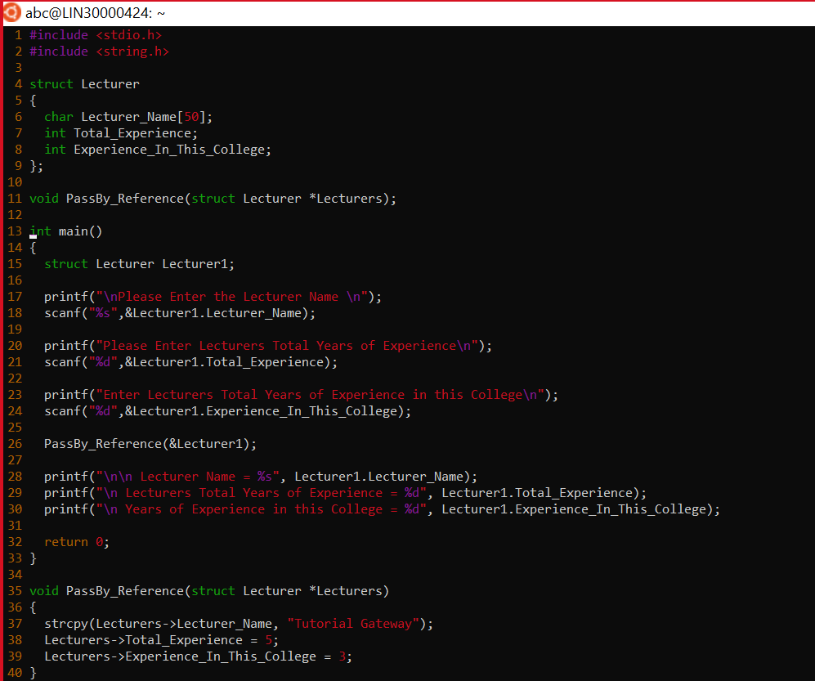
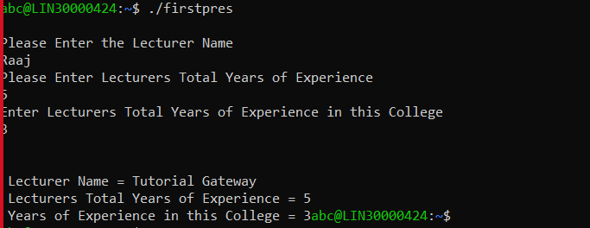
Call by Reference

Slide 12
Structure Padding
CPU can read only one word at a time.
4 bytes for 32-bit compiler and 8 bytes for 64-bit compiler.
So if the size is suppose 6 bytes of structure then it will need 2 cycles to complete that. So to save that mix-up Padding is used.

Slide 13
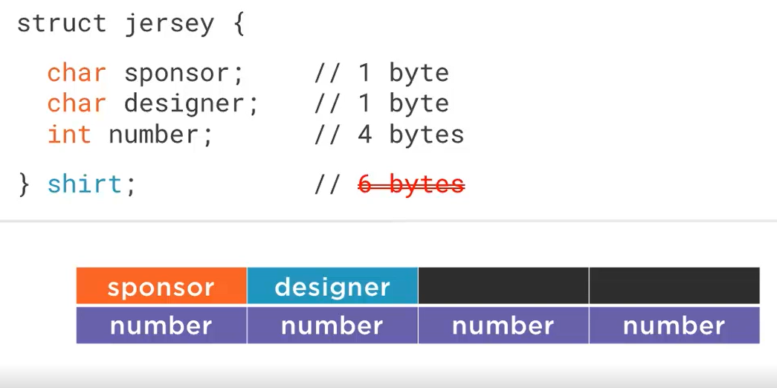
Structure padding
4bytes-32bit machine
8bytes-64bit machine

Slide 14
Structure packing
Sometimes memory gets wasted even though it is being allocated there comes the concept known as structure packing which prevents compiler from doing padding meaning it removes the unallocated space allocated by structure.
#pragma pack(1) is used to pack structure.

Slide 15
Bit Field
Enables access to several bits in c for structure.
Using this fields, it gives access for reading and writing without affecting other bits
Allows to work with data which is smaller than 1 byte and helpful for addressing memory space.
Helps with memory optimization

Slide 16
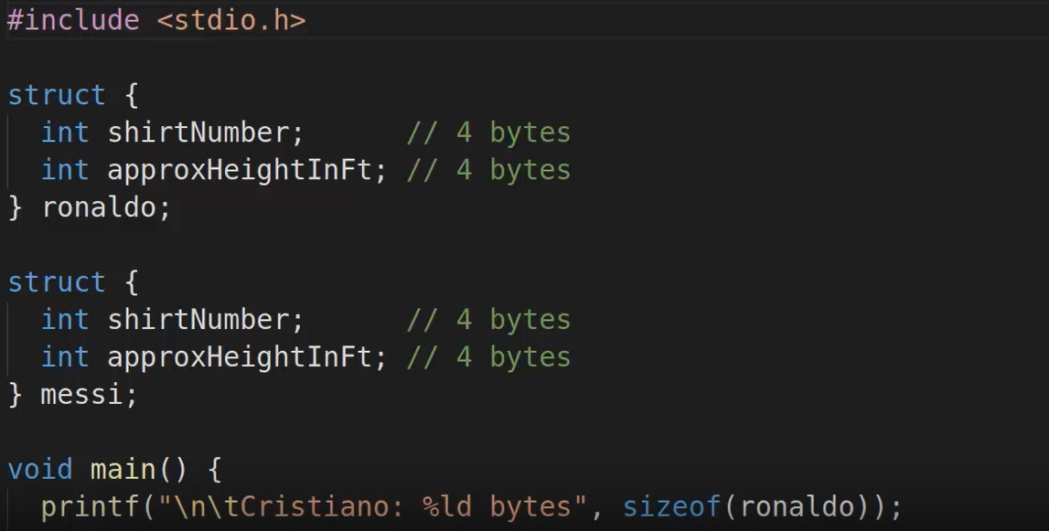
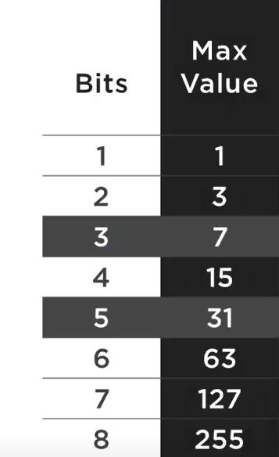

Slide 17
Writing and reading raw data
Structures are most helpful when it comes to read and write raw data. Writing raw data contents using structure, fwrite() is to used that means here, to create a text file use fopen() and if in case it fails that means the file is unreadable only when (fh = NULL).Here it is used to write or update contents in a file
Reading file is just similar to writing raw data. fread() is used to read the contents from the file.

Slide 18
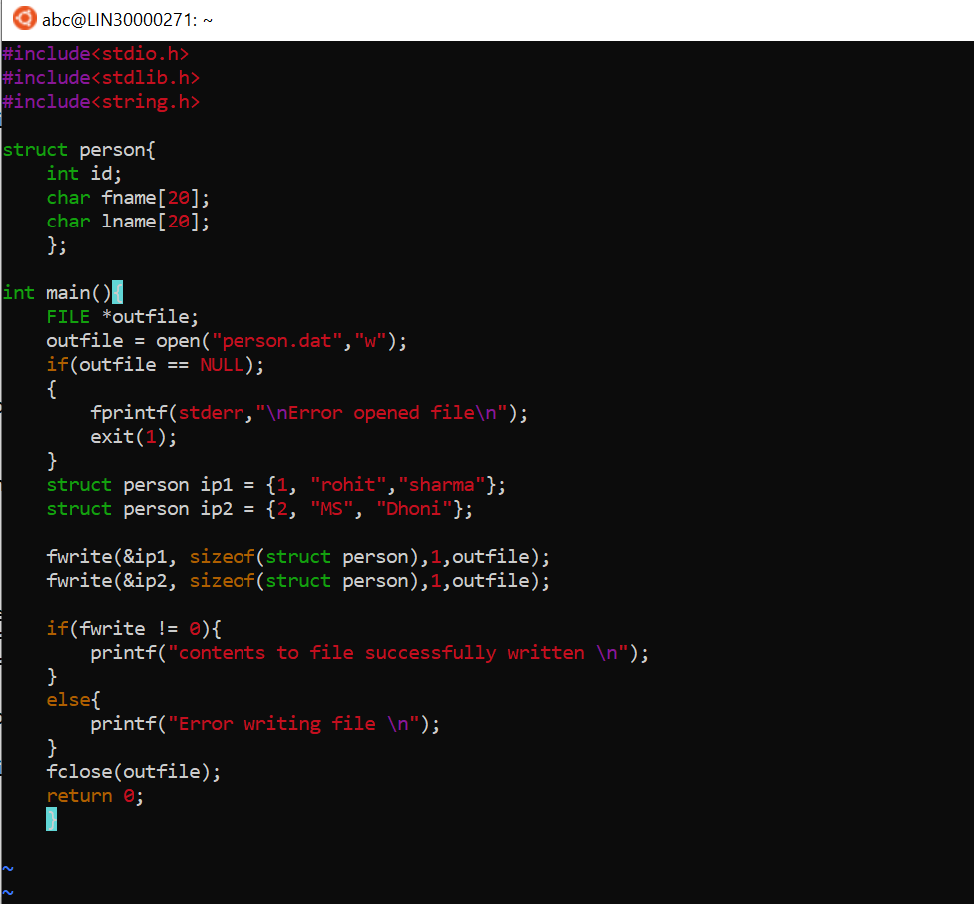
Writing raw data example

Slide 19
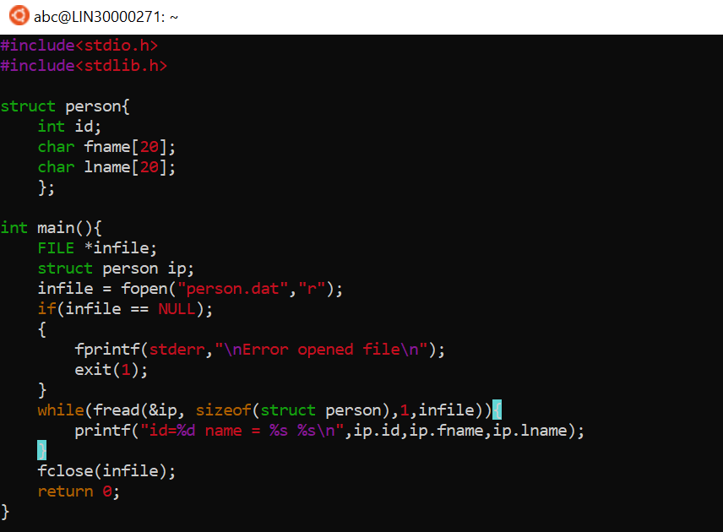
Reading raw data example

Slide 20
Thank you.

